Slide 1
Ri078 & Ri080 Dimensioning & Labeling

Slide 2
Measurement Convention
Height is defined from floor (the normal floor of the classroom) to a standard ceiling tile.
Width
Length

Slide 3
Wall Labels
Interior Wall
Right Wall
Left Wall
Exterior Wall

Slide 4
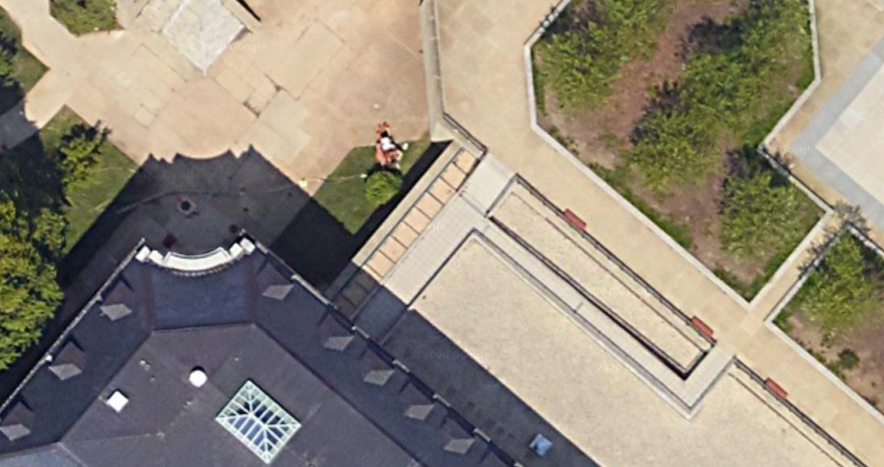


Orientation Referencing
$${40}^{∘}$$
North
Exterior Wall

Slide 5

Directional Wall Labels
Southeast (SE) Wall
Northeast (NE) Wall
Southwest (SW) Wall
Northwest (NW) Wall

Slide 6



World Frame Definition
Southeast (SE) Wall
Northeast (NE) Wall
Southwest (SW) Wall
$$x_{w}$$
$$y_{w}$$
$$o_{w}$$
Northwest (NW) Wall

Slide 7





Frame Definitions
2
1
$$o_{SE}$$
Southeast (SE) Wall
$$o_{SW}$$
Width
Southwest (SW) Wall
Northeast (NE) Wall
$$x_{w}$$
$$o_{NW}$$
$$o_{NE}$$
$$y_{w}$$
$$o_{w}$$
Northwest (NW) Wall
4
3
Length

Slide 8
Actual Lights
2
1
$$o_{SE}$$
Southeast (SE) Wall
$$o_{SW}$$
Width
Southwest (SW) Wall
Northeast (NE) Wall
$$x_{w}$$
$$o_{NW}$$
$$o_{NE}$$
$$y_{w}$$
$$o_{w}$$
Northwest (NW) Wall
4
3
Length

Slide 9
MATLAB Limited (8 max) Lights
2
1
$$o_{SE}$$
Southeast (SE) Wall
$$o_{SW}$$
Width
Southwest (SW) Wall
Northeast (NE) Wall
$$x_{w}$$
$$o_{NW}$$
$$o_{NE}$$
$$y_{w}$$
$$o_{w}$$
Northwest (NW) Wall
4
3
Length

